Slide 1
Design of Experiments – Term Project
Variation of body weight due to diabetes
Sagar Satyanarayana

Slide 2
Randomized Block Design
 | No diabetes | Diabetes from 0-10 Years | Diabetes from >10 Years
White | 80.25 | 94.57 | 88.21
Black | 82.25 | 92.41 | 88.46
Asian | 67.16 | 71.86 | 70.36
Hispanic | 77.66 | 84.23 | 80.18

Slide 3
Assumptions of ANOVA
Independence of cases
Normality
Homogeneity of variances

Slide 4
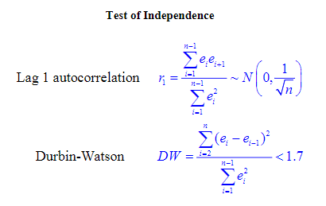
Independence of cases
r1 | 0.261648 | < | 0.565803
DW | 1.082001 | > | 0.17

Slide 5
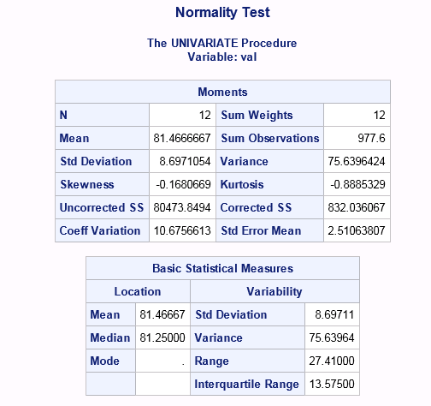
Normality

Slide 6
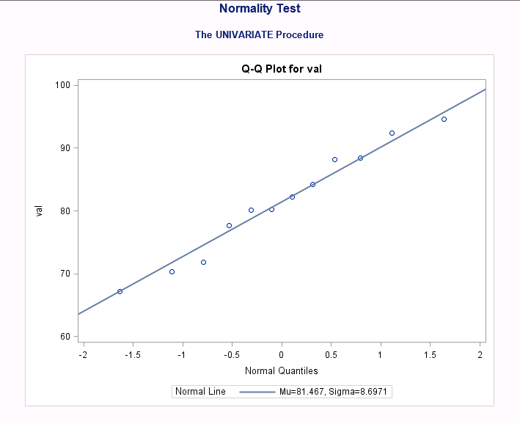

Slide 7
Homogeneity of Variance – Bartlett Test
Range | 15.09 | 22.71 | 18.1
D4Rbar | 209.695
Since all ranges are within D4Rbar, Homogeneity of variance can be assumed

Slide 8
ANOVA
 | df | SS | MS | f test | p value
row/ethnicity | 3 | 643.1149 | 214.3716 | 45.15197 | 0.000164
column/diabetes | 2 | 160.4345 | 80.21726
error | 6 | 28.48668 | 4.747781
total | 11 | 832.0361

Slide 9
SNK Test
Difference | A 76.83 | C 81.8
B 85.77 | 8.94 | 3.97
C 81.8 | -7601.2
Yardstick | A 76.83 | C 81.8
B 85.77 | 10.06079 | 8.219429
C 81.8 | 8.219429

Slide 10
References
United Network for Organ Sharing

